Slide 1
Delegates, Events, and Lambda Expressions

Slide 2
Contents
Delegates
Anonymous methods and lambdas
Events
Annex
Asynchronous delegates
Demos folder:
Demos-07-DelegatesEventsLambdas

Slide 3
1. Delegates
Overview of delegates
Delegates example
Examining the IL for delegates
Multicast delegates

Slide 4
Overview of Delegates
A delegate is a .NET data type that acts as a type-safe pointer to a method on an object/class
A delegate specifies the signature of methods you would like to call through the delegate, e.g.
In your client code, create a delegate instance and bind it to any method (on any object/class) that has the correct signature
In your client code, you can use the delegate to call the method when you're ready
delegate double TrigOp(double radians);
TrigOp op = new TrigOp(Math.Sin); // Long-hand syntax
TrigOp op = Math.Sin; // Equivalent "method-group" syntax.
double result = op(an-angle-in-radians);

Slide 5
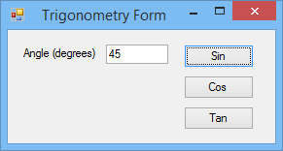
Delegates Example (1 of 3)
Let's see an example of how to define and use simple delegates
See the SimpleDelegates demo project
The sample enables the user to call Math.Sin(), Math.Cos(), or Math.Tan()
All of these methods have the same signature, so we'll use a delegate to invoke the appropriate method

Slide 6
Delegates Example (2 of 3)
// Define a delegate type
delegate double TrigOp(double radians);
// Windows form class
public partial class MainForm : Form
{
…
private void btnSin_Click(object sender, System.EventArgs e)
{
TrigOp op = Math.Sin;
MyPerformOp(op);
}
private void btnCos_Click(object sender, System.EventArgs e)
{
TrigOp op = Math.Cos;
MyPerformOp(op);
}
private void btnTan_Click(object sender, System.EventArgs e)
{
TrigOp op = Math.Tan;
MyPerformOp(op);
}
… See MyPerformOp() method on next slide …
} SimpleDelegates project

Slide 7
Delegates Example (3 of 3)
// Perform the operation indicated by the delegate, "op"
private void MyPerformOp(TrigOp op)
{
if (this.txtDegrees.Text.Length == 0)
{
MessageBox.Show("Please enter an angle.", "Error",
MessageBoxButtons.OK, MessageBoxIcon.Error);
this.txtDegrees.Focus();
return;
}
double degrees = double.Parse(this.txtDegrees.Text);
double radians = (degrees / 360) * 2 * Math.PI;
// Invoke function specified by the "op" delegate
double result = op(radians);
result = Math.Round(result, 4);
MessageBox.Show(result.ToString(), "Result");
this.txtDegrees.Clear();
this.txtDegrees.Focus();
} SimpleDelegates project

Slide 8
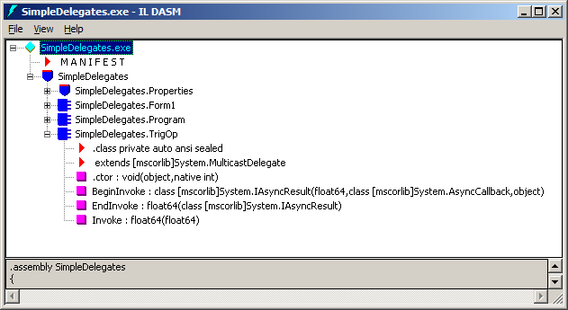
Examining the IL for Delegates (1 of 2)
The compiler generates a new type for the delegate
Invoke() method
Same signature as the delegate itself
Enables clients to invoke methods synchronously
BeginInvoke() and EndInvoke() methods
Enable clients to invoke methods asynchronously (see later…)
delegate double TrigOp(double radians);

Slide 9
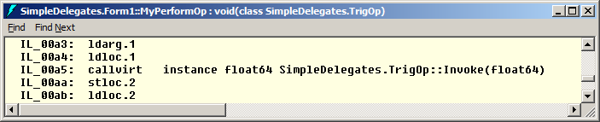
Examining the IL for Delegates (2 of 2)
When you invoke a method via a delegate instance…
The compiler calls Invoke() to call the method represented by the delegate instance
double result = op(radians);
Simple syntax
double result = op.Invoke(radians);
This syntax also works

Slide 10
Multicast Delegates
.NET delegates are "multicast delegates"
You can define a chain of methods to be invoked
Why use multicast delegates?
If you need to perform a series of operations on the same object
If you need to perform an operation on a series of different objects
Both of the above

Slide 11
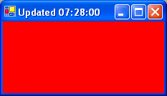
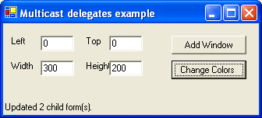

Example of Multicast Delegates
Let's see an example of how to define and use multicast delegates
See the MulticastDelegates demo project
The sample has a main form, which allows the user to create child forms
The user can then change the colour of the child forms
We'll use a multicast delegate to invoke a Repaint() method on each child form
Repaint()
Repaint()

Slide 12
2. Anonymous Methods and Lambdas
Overview of anonymous methods
Anonymous method examples
Outer variables
Overview of lambda expressions
Lambda expression examples
Expression-body members

Slide 13
Overview of Anonymous Methods
An anonymous method is a method with no name
The method just has parameters and a return type
Anonymous methods are used with delegates
Assign an anonymous method to a delegate variable
To call anonymous methods:
You must call anonymous methods through a delegate
You cannot call anonymous methods directly
Internally, the compiler converts anonymous methods into named methods in IL code
Theoretically you could examine the IL using ILDASM, deduce the method names, and then call them by name(!)

Slide 14
Anonymous Method Examples
Here is the formal syntax for defining an "anonymous method expression"
Examples
See the AnonMethodsLambdas demo project
delegate (method-params)_{opt}
{
method-body
}
// Declare a delegate type. AnonMethodsDemo.cs
public delegate void MyDelType(int i);
// Anonymous method definitions.
MyDelType del1 = delegate { }; // OK
MyDelType del2 = delegate() { }; // Type mismatch error
MyDelType del3 = delegate(long l) { }; // Type mismatch error
MyDelType del4 = delegate(int i) { }; // OK
MyDelType del5 = delegate(int i) { return i; }; // Return-type mismatch

Slide 15
Outer Variables (1 of 2)
An anonymous method can access variables declared in the outer scope
These are called "outer variables"
When an outer variable is referenced by an anonymous method, the outer variable is said to be "captured"
The outer variable will not be garbage collected until all delegates referencing the anonymous method become eligible for garbage collection

Slide 16
Outer Variables (2 of 2)
Consider this example
MyMethod declares a local variable, myLocalVar
MyMethod returns anonymous method (via a delegate)
Outside world can call anonymous method via delegate
public delegate int MyDelType(); AnonMethodsOuterVariablesDemo.cs
public class MyClass
{
public static MyDelType MyMethod()
{
int myLocalVar = 0;
return delegate { return ++myLocalVar; };
}
}
MyDelType d = MyClass.MyMethod();
Console.WriteLine(d());
Console.WriteLine(d());

Slide 17
Overview of Lambda Expressions
A lambda expression is a simplified syntax for anonymous methods
Here is the formal syntax for a lambda expression:
Notes:
You don't have to specify parameter types (just names)
If method has multiple parameters, enclose in ()
If method body has multiple statements, enclose in {}
For following examples, see LambdaDemo.cs
(comma-separated-method-params) => method-body

Slide 18
Lambda Expression Examples (1 of 3)
Example 1:
Here's a delegate type that has no parameters
Here are lambda expressions for this delegate type
delegate void MyHandlerNoParams();
MyHandlerNoParams del1 = () => Console.WriteLine("Hello single-line lambda!");
MyHandlerNoParams del2 = () =>
{
Console.WriteLine("Hello multi-line lambda!");
Console.WriteLine("Goodbye multi-line lambda!");
};

Slide 19
Lambda Expression Examples (2 of 3)
Example 2:
Here's a delegate type that takes a single parameter
Here are lambda expressions for this delegate type
delegate void MyHandlerOneParam(int i);
MyHandlerOneParam del1 = i => Console.WriteLine("Via del1, value is {0}.", i);
MyHandlerOneParam del2 = (i) => Console.WriteLine("Via del2, value is {0}.", i);
MyHandlerOneParam del3 = (int i) => Console.WriteLine("Via del3, value is {0}.", i);

Slide 20
Lambda Expression Examples (3 of 3)
Example 3:
Here's a delegate type that takes multiple parameters
Here are lambda expressions for this delegate type
delegate void MyHandlerMultiParams(object sender, EventArgs args);
MyHandlerMultiParams del1 = (sender, args) => Console.WriteLine("Do something1...");
MyHandlerMultiParams del2 = (object sender, EventArgs args) =>
Console.WriteLine("Do something2...");

Slide 21
Expression-Body Members
C#6 allows you to implement 1-line methods and properties as lambda expressions
These are known as "expression-body" members
Example (see ExpressionBodiedMembers.cs)
class Employee ExpressionBodiedMembers.cs
{
public string Name { get; set; }
public double Salary { get; set; }
// Expression-bodied method.
public void PayRaise(double amount) => Salary += amount;
// Expression-bodied (getter) property.
public double TaxPayable => Salary * 0.25;
…
}

Slide 22
3. Events
What are events?
How to define and use events
Worked example

Slide 23
What are Events?
.NET supports events
Familiar to most developers
But different in .NET...
Events are based heavily on delegates
.NET events encapsulate the task of adding event receivers
Also encapsulate the task of notifying event receivers when an event is raised

Slide 24
How to Define and Use Events
Follow these steps:
Define an 'event argument' class, to hold context information when an event is raised
Define a delegate type, to specify the signature of the event (i.e. event handlers must have this signature)
In your event-source class, publish events using the event keyword
In the event-source class, raise events when something interesting happens
In the client code, subscribe to the events you're interested in
Provide event-handler methods (with same signature as event)
Event-handler methods will be called when the event is raised
1
2
3
4
5

Slide 25
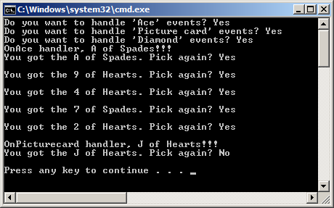
Example (1 of 6)
Let's see an example of events
See the Events demo project
The sample has a CardDealer class, which deals playing cards randomly from a pack
The CardDealer raises three different events
When an Ace is dealt
When a picture card is dealt
When a diamond is dealt
The client code chooses whether it wants to be notified of these events

Slide 26
Example (2 of 6)
Define an 'event argument' class
public class CardEventArgs : EventArgs
{
// Private fields
private string mNumber, mSuit;
// Constructor, to initialize private fields
public CardEventArgs(string number, string suit)
{
mNumber = number;
mSuit = suit;
}
// Properties, to get the values held in the private fields
public string Number
{
get { return mNumber; }
}
public string Suit
{
get { return mSuit; }
}
} Events project

Slide 27
Example (3 of 6)
Define a delegate type to define the event signature, using the following conventions:
Delegate type name is XxxxEventHandler
Parameter 1 is the event source, the object that raised the event
Parameter 2 is an EventArgs (or subclass), provides context info
Alternatively, use the standard EventHandler<T>
See next slide
public delegate void CardEventHandler(object source, CardEventArgs e);

Slide 28
Example (4 of 6)
In your event-source class, publish events using the event keyword
You can use EventHandler<T> to designate signatures
public class CardDealer
{
// Publish events, using our delegate type to denote the signatures.
public event CardEventHandler AceEventHandler;
public event CardEventHandler PicturecardEventHandler;
public event CardEventHandler DiamondEventHandler;
// Plus other fields, methods, etc (see next slide…)
} Events project
public class CardDealer
{
// Alternative syntax, using EventHandler<T> to denote the signatures.
public event EventHandler<CardEventArgs> AceEventHandler;
public event EventHandler<CardEventArgs> PicturecardEventHandler;
public event EventHandler<CardEventArgs> DiamondEventHandler;
…
} Events project

Slide 29
Example (5 of 6)
Raise events when something interesting happens
static string[] NUMBERS = { "A", "2", "3", …, "J", "Q", "K" };
static string[] SUITS = { "Clubs", "Diamonds", "Hearts", "Spades" };
public void Deal(out string number, out string suit)
{
Random rg = new Random();
number = NUMBERS[rg.Next(0, 13)];
suit = SUITS[rg.Next(0, 4)];
if (number == "A")
{
if (AceEventHandler != null)
AceEventHandler(this, new CardEventArgs(number, suit));
}
else if (number == "J" || number == "Q" || number == "K")
{
if (PicturecardEventHandler != null)
PicturecardEventHandler(this, new CardEventArgs(number, suit));
}
if (suit == "Diamonds")
{
if (DiamondEventHandler != null)
DiamondEventHandler(this, new CardEventArgs(number, suit));
}
} Events project

Slide 30
Example (6 of 6)
In the client code, subscribe to events of interest
public static void Main()
{
CardDealer dealer = new CardDealer();
…
dealer.AceEventHandler += OnAce;
dealer.PicturecardEventHandler += OnPicturecard;
dealer.DiamondEventHandler += OnDiamond;
…
dealer.Deal(out number, out suit);
}
private static void OnAce(object source, CardEventArgs e)
{
Console.Write("OnAce handler, {0} of {1}!!!", e.Number, e.Suit);
}
private static void OnPicturecard(object source, CardEventArgs e)
{
Console.Write("OnPicturecard handler, {0} of {1}!!!", e.Number, e.Suit);
}
private static void OnDiamond(object source, CardEventArgs e)
{
Console.Write("OnDiamond handler, {0} of {1}!!!", e.Number, e.Suit);
} Events project

Slide 31
Summary
Delegates
Anonymous methods and lambdas
Events

Slide 32
Annex: Asynchronous Delegates
Overview of asynchronous delegates
Asynchronous delegates example
Additional techniques

Slide 33
Overview of Asynchronous Delegates
The examples so far have been synchronous delegates
You must wait for the called method to terminate, before you can continue processing
.NET also supports asynchronous delegates
Create a delegate to represent the method you want to call asynchronously
Call BeginInvoke() to invoke the method asynchronously
Use an AsyncCallback delegate to identify a callback method
The callback method will be called when the asynchronous method has completed
In the callback method, call EndInvoke() to access the return value (plus out/ref params) from the async method

Slide 34
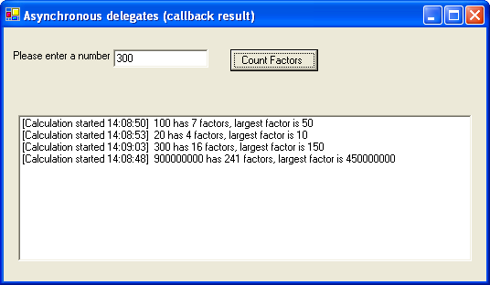
Example (1 of 4)
Let's see an example of asynchronous delegates
See the AsyncDelegates demo project
The sample allows the user to count how many factors there are in a given number
This might take a while, so do the calculation asynchronously
We'll use an AsyncCallback delegate to specify a callback, which will be called when the result is ready

Slide 35
Example (2 of 4)
public class MainForm: System.Windows.Forms.Form
{
// Define a Delegate type for the asynchronous method
delegate int MyDelegate(ref int Number, out int LargestFactor);
// Handle the Click event for the btnCountFactors button
private void btnCountFactors_Click(object sender, System.EventArgs e)
{
int number = int.Parse(txtNumber.Text);
// Create delegate, for a "find factor" method
FactorFinder aFactorFinder = new FactorFinder();
MyDelegate theDel = aFactorFinder.MyCountFactors;
// Create an AsyncCallback delegate, for our "callback" method
AsyncCallback callbackDel = this.MyProcessAsyncResults;
// Invoke the "factor finder" method asynchronously
int temp;
theDel.BeginInvoke(ref number, // 1st param to MyCountFactors()
out temp, // 2nd param to MyCountFactors()
callbackDel, // Callback delegate
DateTime.Now); // State, accessible by callback
}
} AsyncDelegates project

Slide 36
Example (3 of 4)
// Callback method, to handle the result of the asynchronous method
private void MyProcessAsyncResults(IAsyncResult ar)
{
// Downcast IAsyncResult interface into AsyncResult class type
AsyncResult result = (AsyncResult)ar;
// Get our delegate from the AsyncResult object
MyDelegate theDelegate = (MyDelegate)result.AsyncDelegate;
// Get the results of the asynchronous method
int factorCount = 0, number = 0, largestFactor = 0;
factorCount = theDelegate.EndInvoke(ref number, out largestFactor, ar);
// Get the "state" out of the result
DateTime timeStarted = (DateTime)ar.AsyncState;
if (factorCount == 0)
lstResults.Items.Add("[Calculation started " +
timeStarted.ToLongTimeString() + "] " +
number + " is a prime number");
else
lstResults.Items.Add("[Calculation started " +
timeStarted.ToLongTimeString() + "] " +
number + " has " + factorCount +
" factors, largest factor is " + largestFactor);
} AsyncDelegates project

Slide 37
Example (4 of 4)
// Factor finder class, just in case you're interested :-)
public class FactorFinder
{
// This method does not know it is being invoked asynchronously
public int MyCountFactors(ref int number, out int largestFactor)
{
largestFactor = 0;
int factorCount = 0;
// Count the number of factors, and also find the largest factor
for (int i = 2; i < number; i++)
{
if (number % i == 0)
{
factorCount++;
largestFactor = i;
}
}
// Return the number of factors
return factorCount;
}
} AsyncDelegates project

Slide 38
Additional Techniques
StopWatch demo project:
Performing work in a background thread
DemoDelegatesAndEvents demo project:
Asynchronous delegates (call-back and polling)
Using the EventArgs<T> generic type
Lambda expressions and event handling
Note:
See the next chapter for more details about generics

Slide 39
Any Questions?

